Slide 1
Stroke Analysis and Prediction
-Harshitha Chollangi

Slide 2
Overview
Introduction
Problem Description
Algorithms considered
Dataset Description and Analysis
Performance Analysis
Conclusion and Future Scope

Slide 3
Introduction
According to the World Health Organization (WHO), stroke is the greatest cause of death and disability globally.
01
Stroke, the 2nd leading global cause of death, prompts the need for predictive analytics.
02
The goal is to build a robust stroke prediction model to enhance clinical decision-making.
03
The dataset encompasses 5110 observations with 12 attributes capturing key patient information.
04
Input parameters include gender, age, diseases, and smoking status to predict stroke probability.
05

Slide 4
Problem Description
Early recognition of the various warning signs of a stroke can help reduce the severity of the stroke.
Stroke can be induced by factors such as
Smoking
Drinking
Body Mass Index (BMI)
Average Glucose Level and
Heart Problems.

Slide 5
Algorithms
Different machine learning models have been adapted to predict stroke
Linear Model (including multilinear model, poly model, improved LM)
Random forest model
logistic regression model
Naive Bayes Classification
K-Nearest Neighbor classification
Linear SVM*
Simple Decision Tree Modelling*
XGBoost

Slide 6
Dataset Description
S.NO | Feature | Type
1 | Gender | Categorical
2 | Age | Numeric
3 | Has Hypertension | Binary
4 | Has Heart Disease | Binary
5 | Is married | Binary
6 | Work Type | Categorical
7 | Residence Type | Categorical
8 | AVG Glucose | Numeric
9 | BMI | Numeric
10 | Smoking habits | Categorical
11 | Stroke | Binary

Slide 7
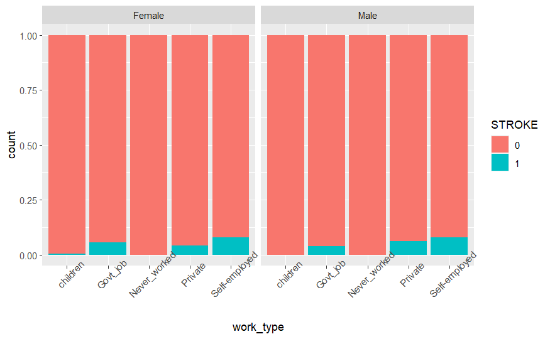
Self-employed people have higher stroke percentage than people working on private sector and governmental sector respectively, this means low security jobs have higher impact on having stroke.

Slide 8
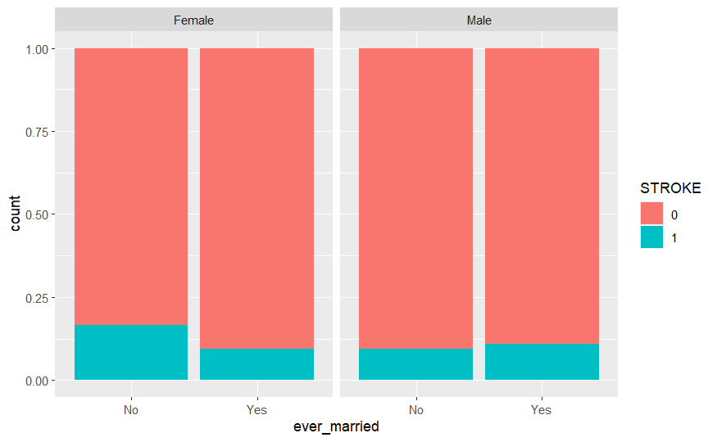

Slide 9
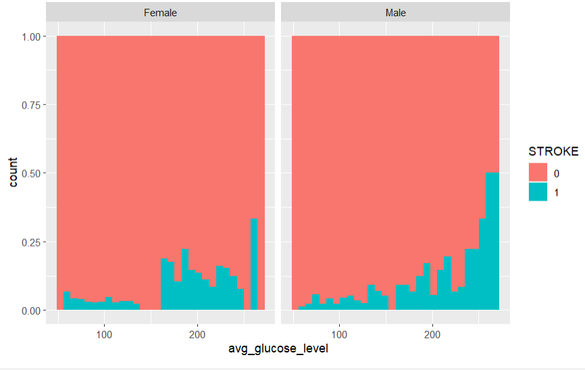

Slide 10
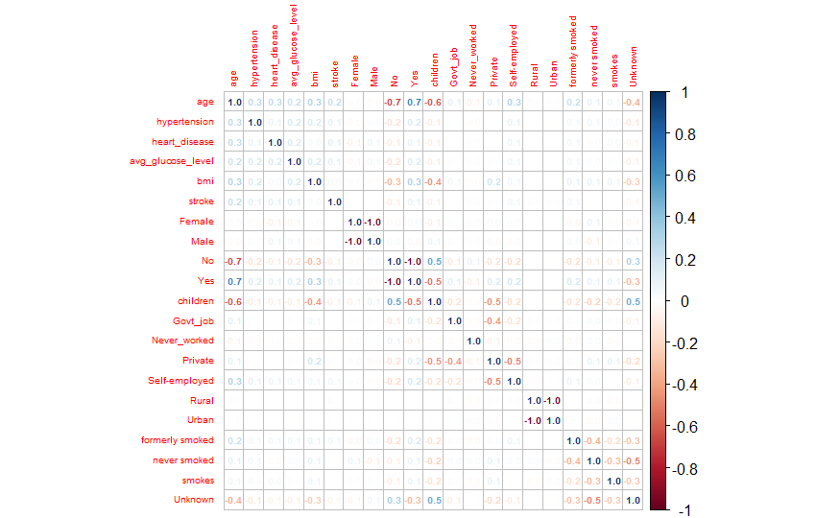
Correlation matrix (Post Pre-Processing)

Slide 11
Model Metrics
Model | Accuracy | Recall | Precision | F1_Score | AUC | RMSE
Linear | 0.7903107 | 0.1571730 | 0.7198068 | 1 | 0.5693479 | 0.4579184
Poly | 0.8235870 | 0.1787500 | 0.6908213 | 1 | 0.5796397 | 0.4200155
GLMNet | 0.8245657 | 0.1772152 | 0.6763285 | 1 | 0.5784468 | 0.4188488

Slide 12
Performance Results
Model | Accuracy | Precision | Recall | F1
Logistic Regression | 0.9559902 | 0.37500000 | 0.05769231 | 0.10000000
KNN | 0.9250204 | 0.02380952 | 0.01923077 | 0.02127660
SVM | 0.9576202 | 0.50000000 | 0.01923077 | 0.03703704
Naive Bayes | 0.5607172 | 0.07652174 | 0.84615385 | 0.14035088
Decision Tree | 0.9576202 | 0.95762021 | 1.00000000 | 0.97835137
Random Forest | 0.9437653 | 0.16000000 | 0.07692308 | 0.10389610
XGBoost | 0.9568052 | 0.95758564 | 0.99914894 | 0.97792586
Measures the overall correctness of the model's predictions. The models with the highest accuracy are Logistic Regression (0.956), SVM (0.958), and XGBoost (0.957).

Slide 13
https://harshithachollangi.shinyapps.io/AppliedDataMiningProjectR/

Slide 14
Conclusion
Age and Stroke Risk:
Stroke percentage increases with age and peaks near the end of the 70s. Notably, there are no observations of males having a stroke below the age of 40, while several females experience strokes before reaching their 40s, including cases around 30, 15, and even below 1 year old.
Gender Disparities:
The dataset reveals a gender-related pattern where hypertension has a slightly higher effect on females than males. Additionally, married individuals, particularly females, seem to have a lower risk of stroke compared to unmarried individuals. The impact of heart disease is similar for both genders.
Occupation and Stroke Risk:
Self-employed individuals have a higher stroke percentage compared to those working in the private and governmental sectors. This suggests that occupations with lower job security may have a higher impact on stroke risk.
Useful Classification:
The classification based on gender appears to be particularly useful in understanding stroke risk factors. The observations regarding age, hypertension, marital status, and occupation also provide valuable insights into potential predictors of stroke.

Slide 15
Future Scope for Improvement:
Refinement of Age Analysis:
Further investigation into the specific age ranges associated with increased stroke risk could enhance the model's precision. This might involve creating age brackets or exploring nonlinear relationships between age and stroke risk.
Exploration of Lifestyle Factors:
Consider incorporating additional lifestyle factors, such as diet, physical activity, and stress levels, to provide a more comprehensive understanding of stroke risk. This could improve the model's predictive accuracy and contribute to more targeted preventive measures.

